Slide 1
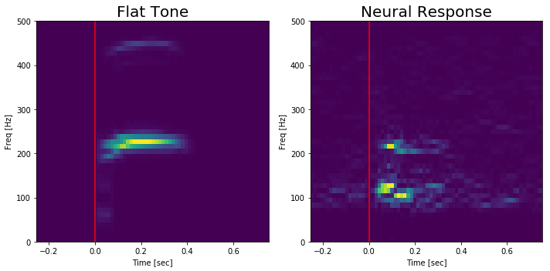
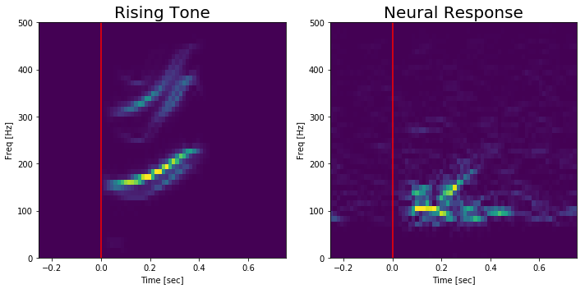
Evidence of FFR in the Heschls Gyrus
B
Stimulus onset
Heschls Gyrus
A
The spectrograms display the average stimulus for the flat tone (T1) and the rising tone (T2) and the average neural response (over passive and active trials) for one Heschls Gyrus electrode (Fig.A).
These provide evidence of pitch tracking in the Heshls Gyrus.
The FFR in response to stimuli may be a representative of tone learning.

